Slide 1


Crossing the Silk Roads by Cars and Ships
The Silk Road Expedition Projects of SUN (Silk-Road Universities Network)
Inspiring young students so that they can take pride in the value of the Silk
Roads and the beauty of cultural diversities in harmony along the Silk Roads
thru expeditions of the land as well as maritime Silk Roads.

Slide 2
Contents
1. “The 21C Marco Polo Project” – A Silk Road Ride for Peace and Co-prosperity
2. Expedition of the Maritime Silk Route by Ship: 3 Phases
3. A Proposal:
“The Maritime Silk Route Expedition by Ship for Celebrating the 1600th Anniversary of Venice”

Slide 3
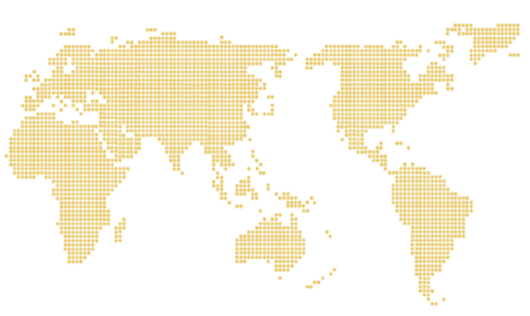

1. “The 21C Marco Polo Project” – A Silk Road Ride for Peace and Co-prosperity
A Cross-Silk Road Car-Riding from Venice, Italy to North and South Korea
by university students all over the world
Passing through North Korea together with North Korean students

Slide 4
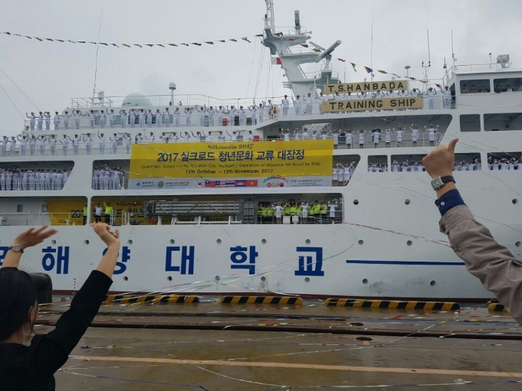
2. Expedition of the Maritime Silk Route by Ship: 3 Phases
Phase I : Done already in 2017 from Busan, Korea to Ho Chi Minh City, Vietnam via
Manila in Philippines, Melaka in Malaysia, Bangkok in Thailand, and Sihanoukville
in Cambodia
Phase II : from Malaka, Malaysia to Dubai, UAE across Indian Ocean
Phase III : from Lisbon to Muscat, Oman along the shorelines of Africa
Phase I
(done already)
Phase II
Phase III
31

Slide 5
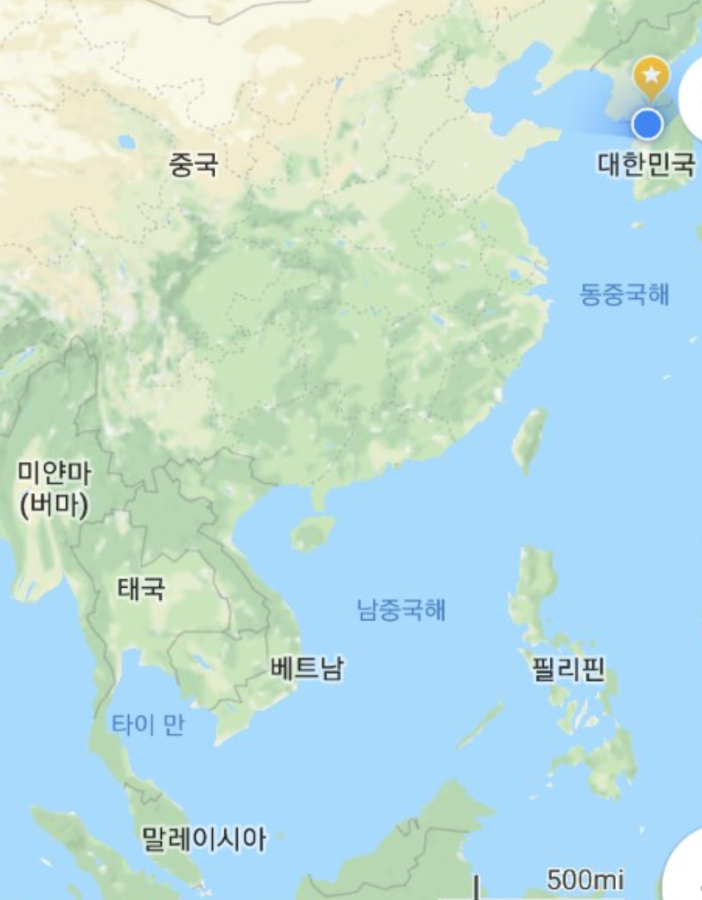
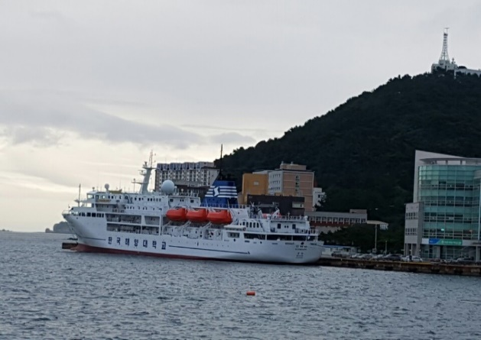

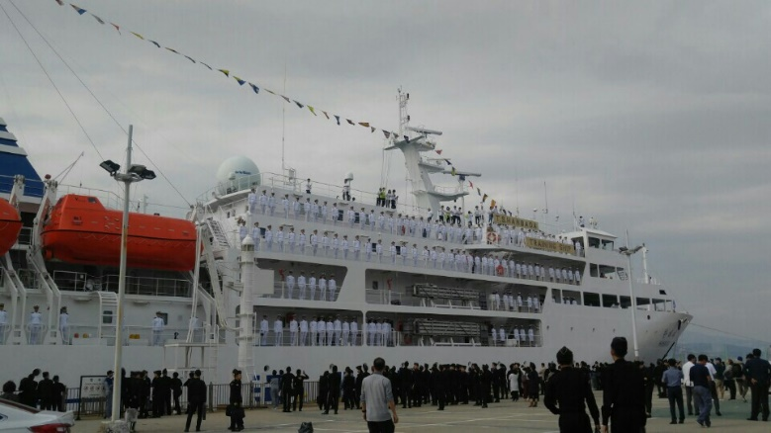
The 1st Phase of the Maritime Silk Roads Expedition
The Expedition of the Asian Maritime Silk Route by Ship in 2017
6 Ports in 5 Countries:
Busan, Korea -> Pohang, Korea -> Manila, Philippines -> Melaka, Malaysia -> Bangkok, Thailand -> Sihanoukville, Cambodia -> Ho Chi Minh City, Vietnam
Duration of Voyage: 36 days from October 6 ~ November 12, 2027
Ship: “Hanbada Ho,” a Training Ship of the Korea Maritime & Ocean University
Participants: 200 Students of member universities of SUN in Italy, Turkey, China, Mongolia, Malaysia, Kyrgyzstan, Philippines, Cambodia, Vietnam, Korea

Slide 6
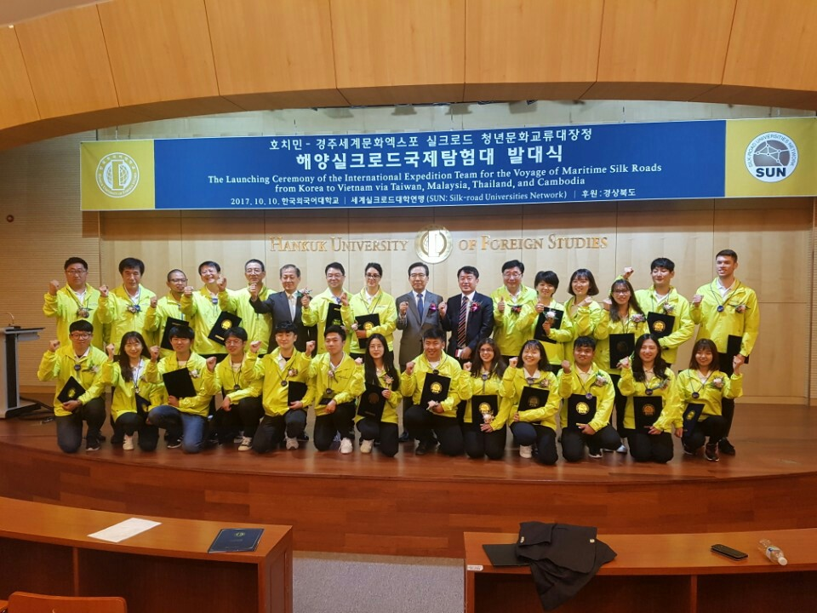

Slide 7
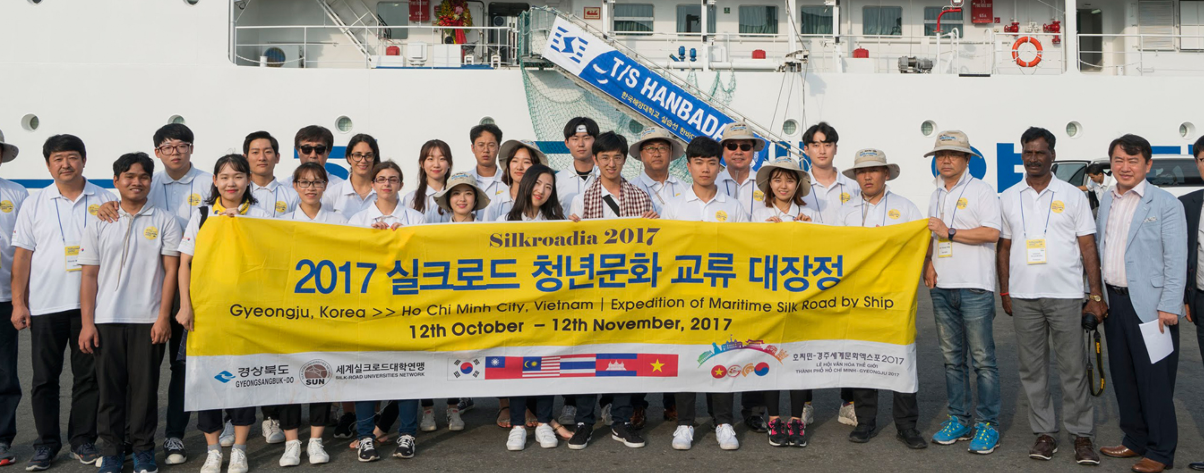
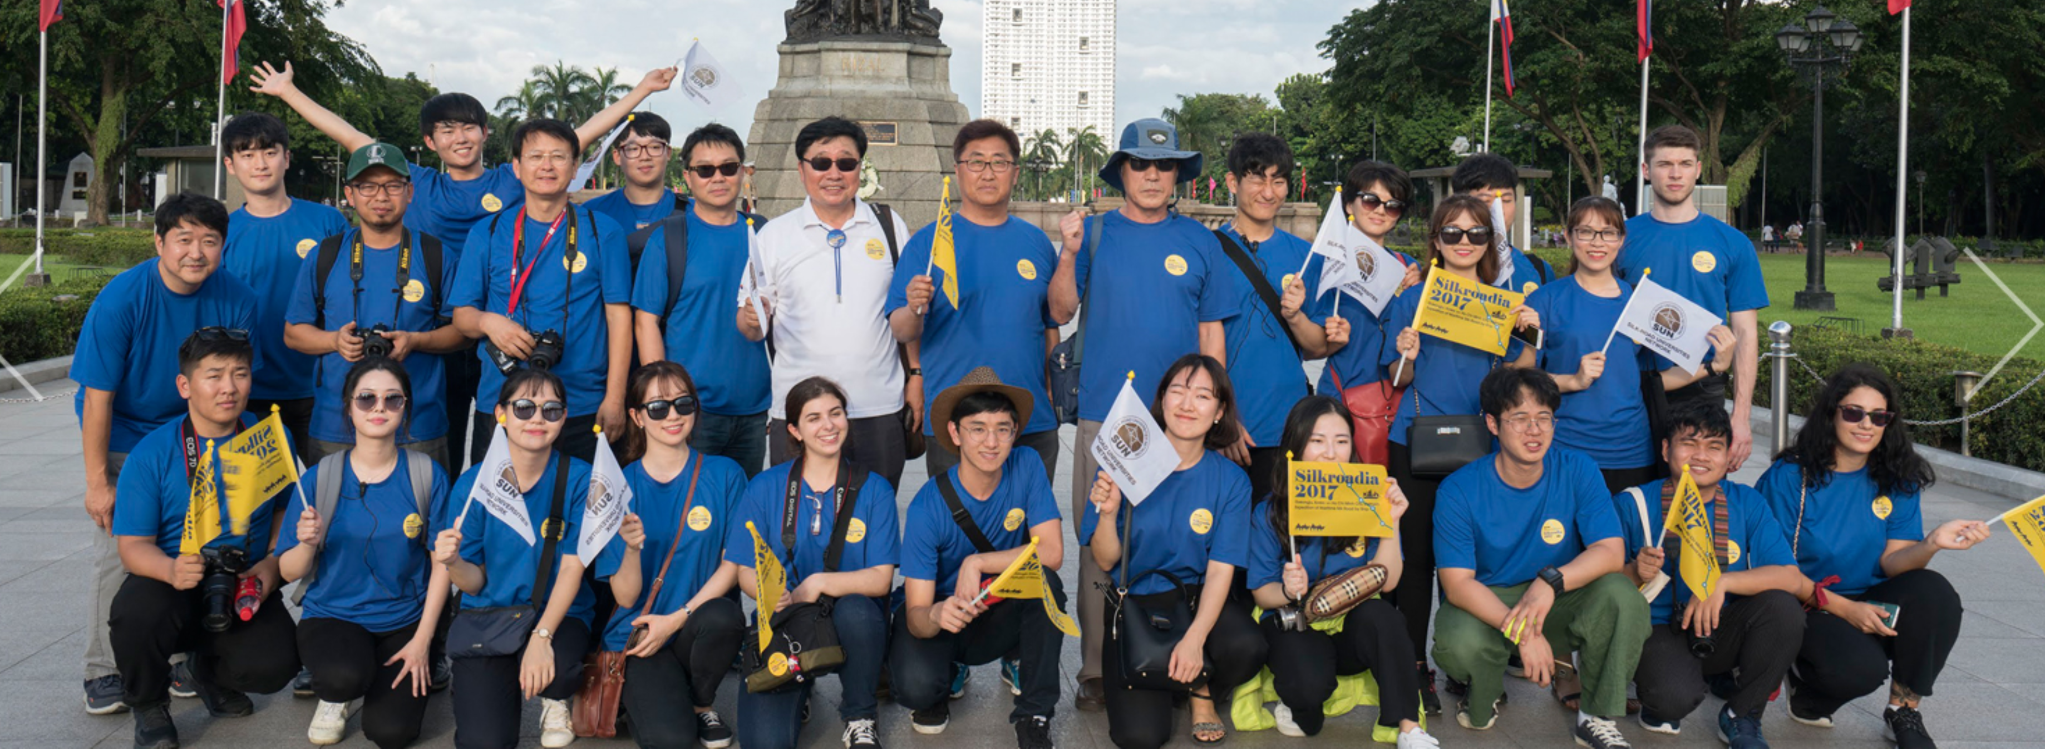

Slide 8
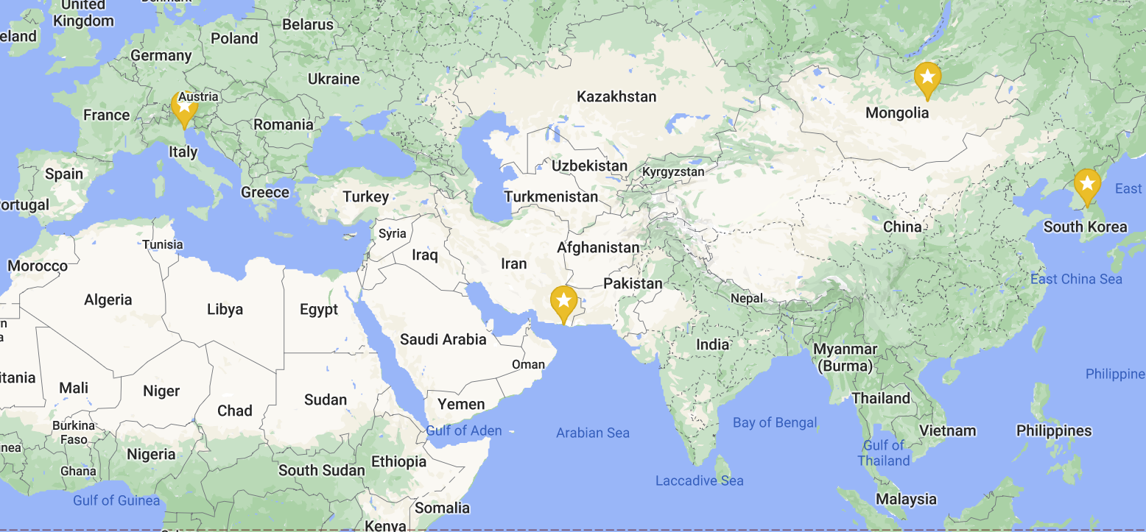
3. A Proposal:
“The Maritime Silk Route Expedition by Ship for Celebrating the 1600th Anniversary of Venice”
●
Route & Transportation:
China -> Vietnam -> Malaysia -> Sri Lanka -> India -> Iran -> Turkey
-> Greece -> Montenegro -> Venice, Italy
by ship (training ship of the National Naval Academy of China)
by cars
by ship (training ship of the National Naval Academy of Italy)
●
Duration: 1-2 Months
●
Participants: 100 ~ 200 Students of SUN Member Universities

