Slide 1
Venice T-Shirt Pattern Design Contest
PPT made by: Dohun Kim, SUN coordinator

Slide 2
1. Criteria & Stage of the evaluation
Criteria 1. Creativity-How ingeniously, creatively did the applicant approach to the theme.
Criteria 2. Way of expressing the theme, technique, and level of completion.
- Criteria made by: Mr. Eui Hwan Cho, Advisor, Art Director & Photographer

Slide 3
1. Criteria & Stage of the evaluation
Stage 1. Selecting the 5 best designers each regardless of the number of works the applicants submitted.
Stage 2. Among the chosen designers, choosing the best three
- Criteria made by: Mr. Eui Hwan Cho, Advisor, Art Director & Photographer

Slide 4
2. Introducing the works
The Best Three works:
Design No.1600-151 by Ms. Martina Gori, Ca’Foscari University of Venice
Design No.1600-161 by Mr. Muhammad Ali Aizat Bin Abu Bakar, University of Malaya
Design No.1600-112 by Ms. Hasti Jalouti, University of Tehran(non-member)
* The serial numbers are based on the alphabetical order of the designers’ names and the number of works they submitted. Ex) 1600-11(Hasti Jalouti) 2(Second Work).

Slide 5
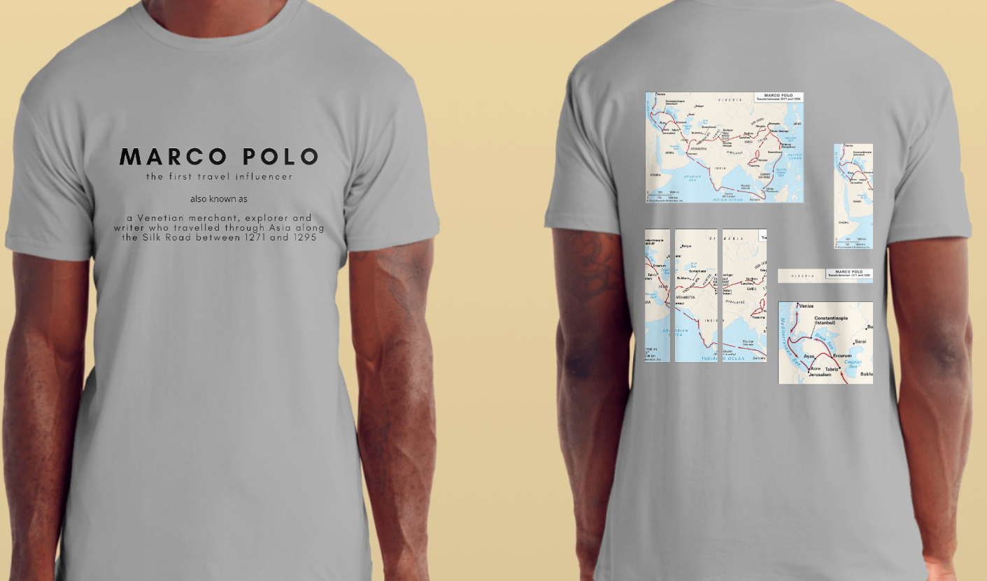
2. Introducing the works
Design No.1600-151 by Ms. Martina Gori, Ca’Foscari University of Venice
Comment by the Chairperson
-Mr. Eui Hwan Cho
The unique rear design, which expresses the journey to the unknown world east from 1271 to 1295 experienced by the Venetian Marco Polo, is simple and increases the completeness of the design by cutting and enlarging parts of it. The typography design, which has no decoration on the front and is organized in a modern Sanserif style, also adds simplicity.

Slide 6
2. Introducing the works
Design No.1600-151 by Ms. Martina Gori, Ca’Foscari University of Venice
Comment by the committee member
-Ms. Eugenia Sainz
The theme is “Marco Polo”. The design created by Martina Gori is modern, original, and very refined with attention to the smallest details. Particularly noteworthy is the elegance of the light gray chosen for the shirt, the elegance of the graphic textual characters, and the color combination applied to the geographical representation of Marco Polo’s travels. Furthermore, from an ideational point of view, the reinterpretation of the merchant-explorer as an “influencer” is a very innovative and successful idea.

Slide 7
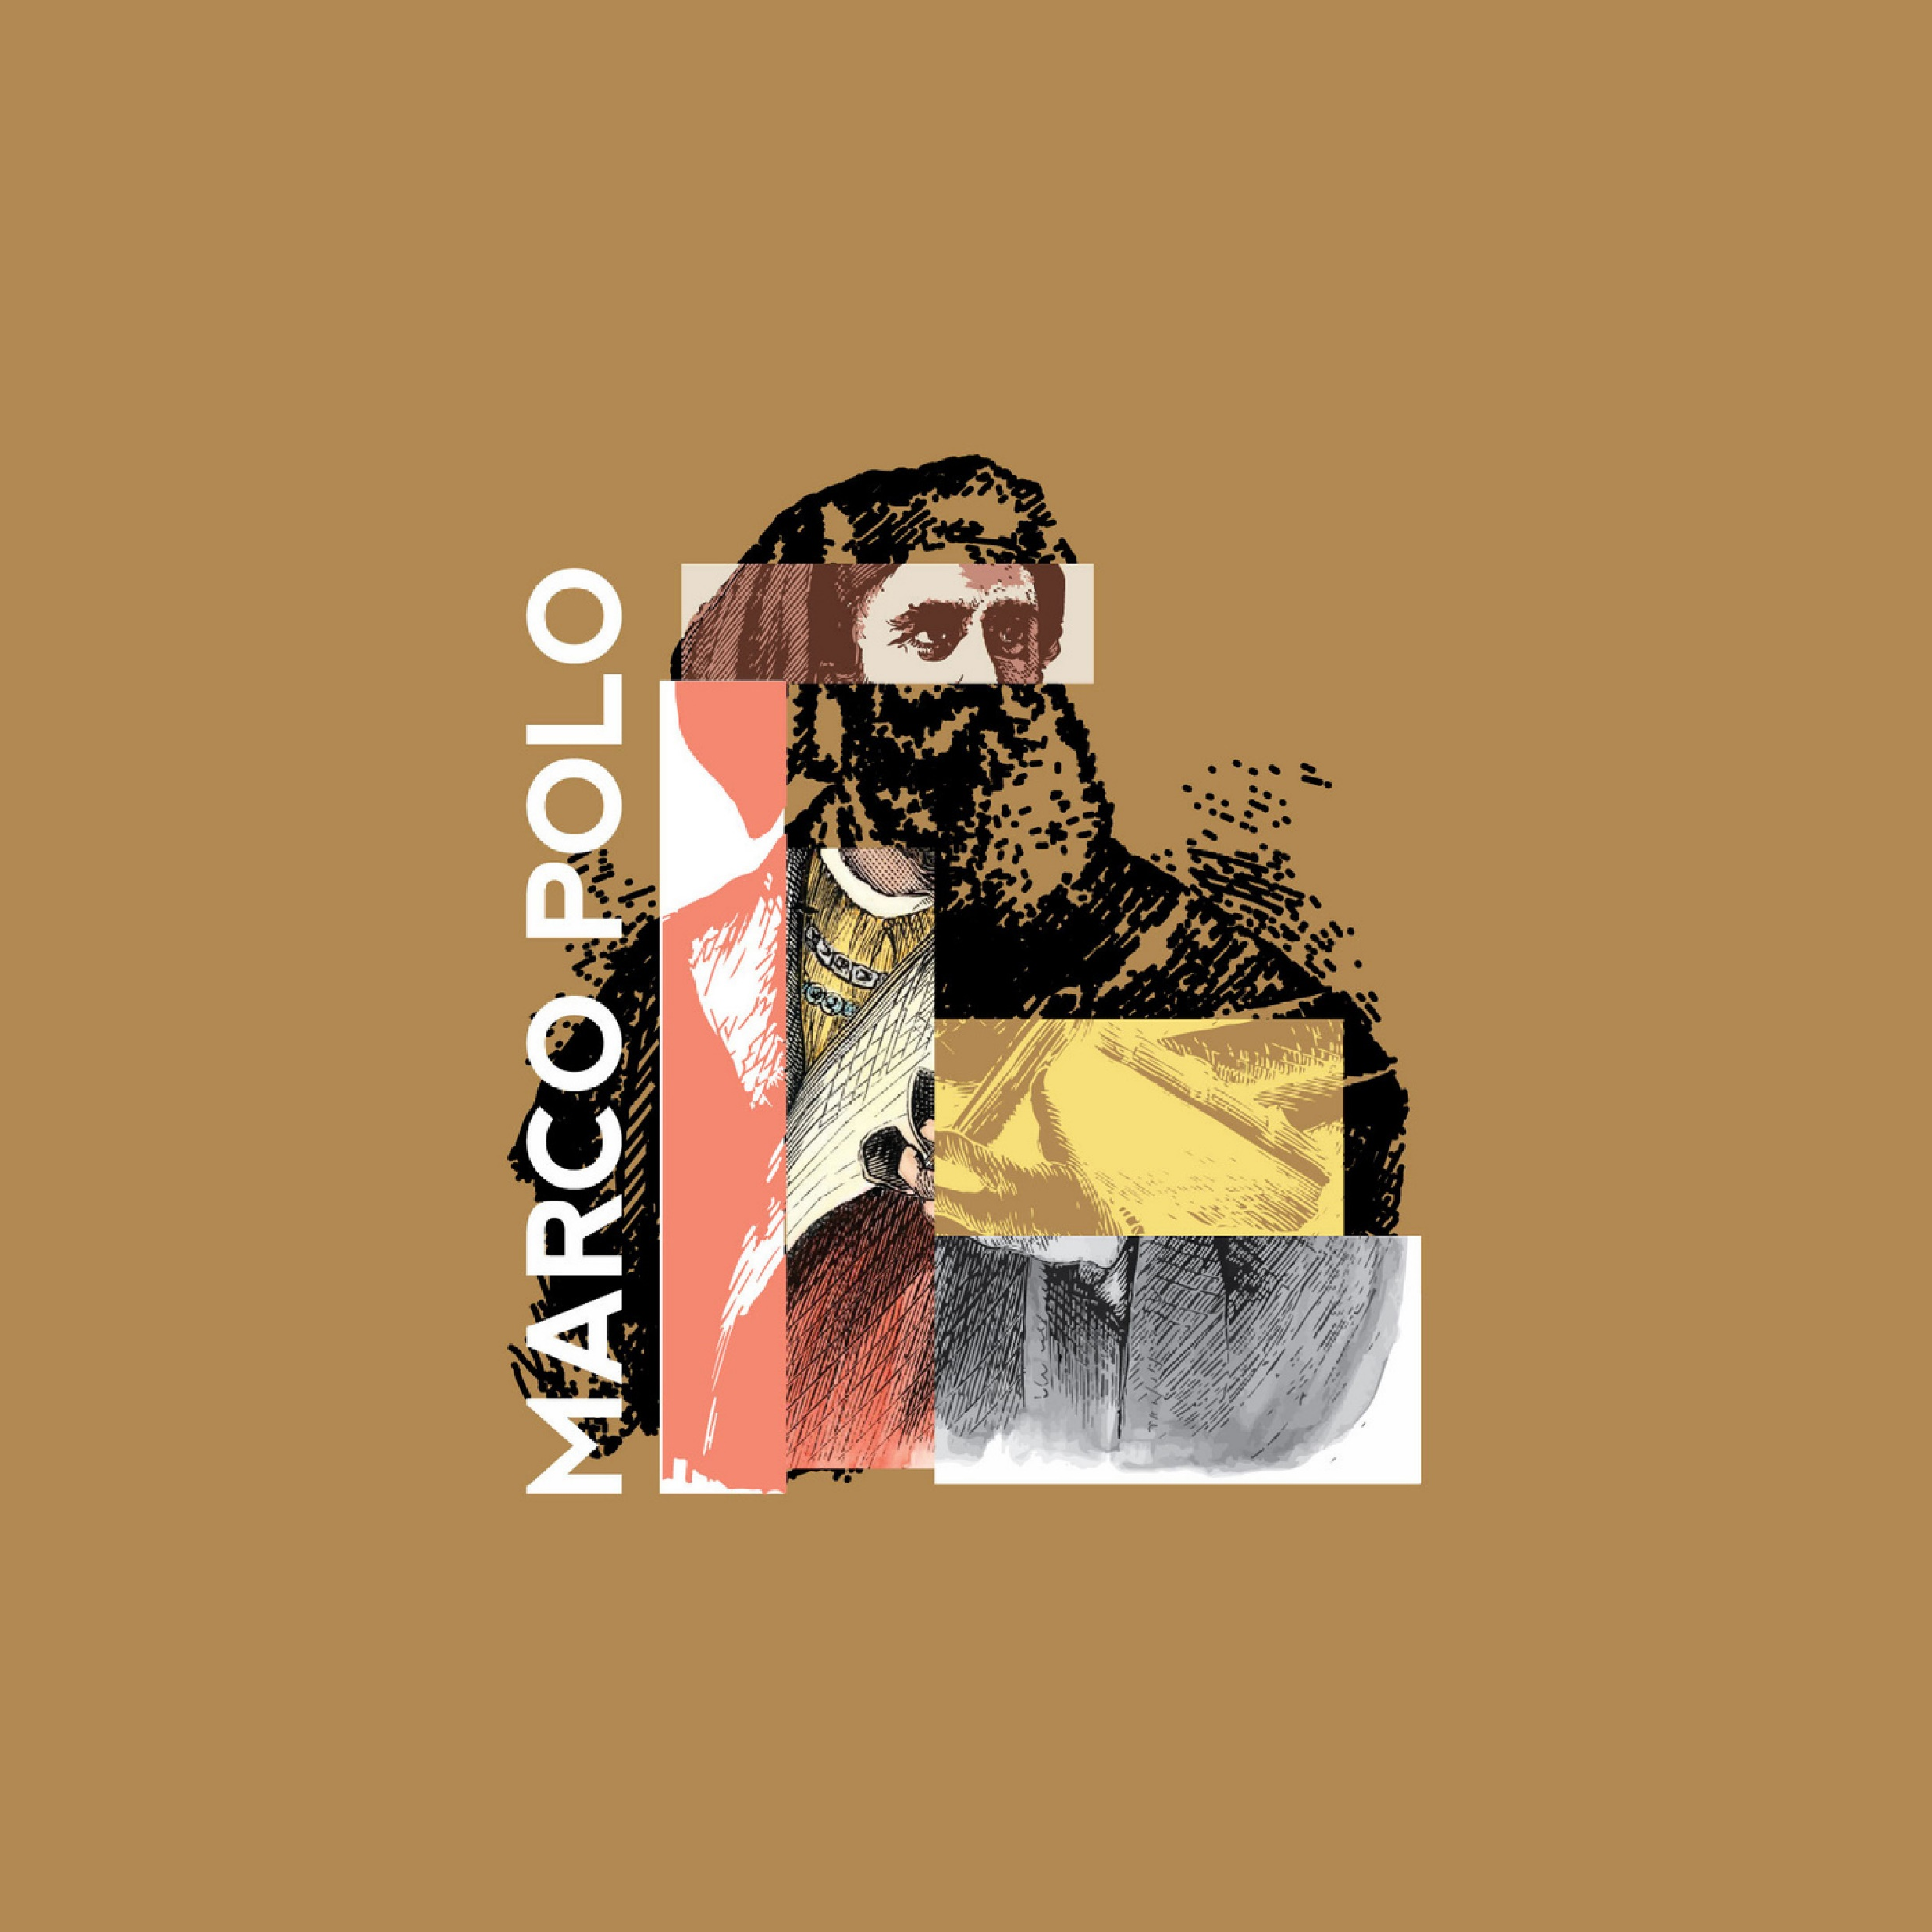
2. Introducing the works
Design No.1600-161 by Mr. Muhammad Ali Aizat Bin Abu Bakar, University of Malaya
Comment by the chairperson
-Mr. Cho
It is an illustration of the bust of a Marco Polo in a collage technique made by cutting the body part with several different techniques and attaching a drawn piece. It is enough to make the subject interesting, which almost might have become a cliche, and in particular, the eyes of Mark Polo, which are brighter than the background, can feel the intense gaze as if looking at the unknown world. It is also good to arrange the letters vertically like columns.

Slide 8
2. Introducing the works
Design No.1600-161 by Mr. Muhammad Ali Aizat Bin Abu Bakar, University of Malaya
Comment by the committee member
-Ms. Eugenia Sainz
The theme is “Marco Polo”. The design created by Muhammad Ali Aizat Bin Abu Bakar focuses on the personality of the Venetian merchant-explorer. His image is geometrically deconstructed to highlight the traveler's gaze and his hand holding a book: attention, curiosity, and study. The chromatic composition gives strength to the figure. The white color for the vertical name on the left is an excellent choice.

Slide 9
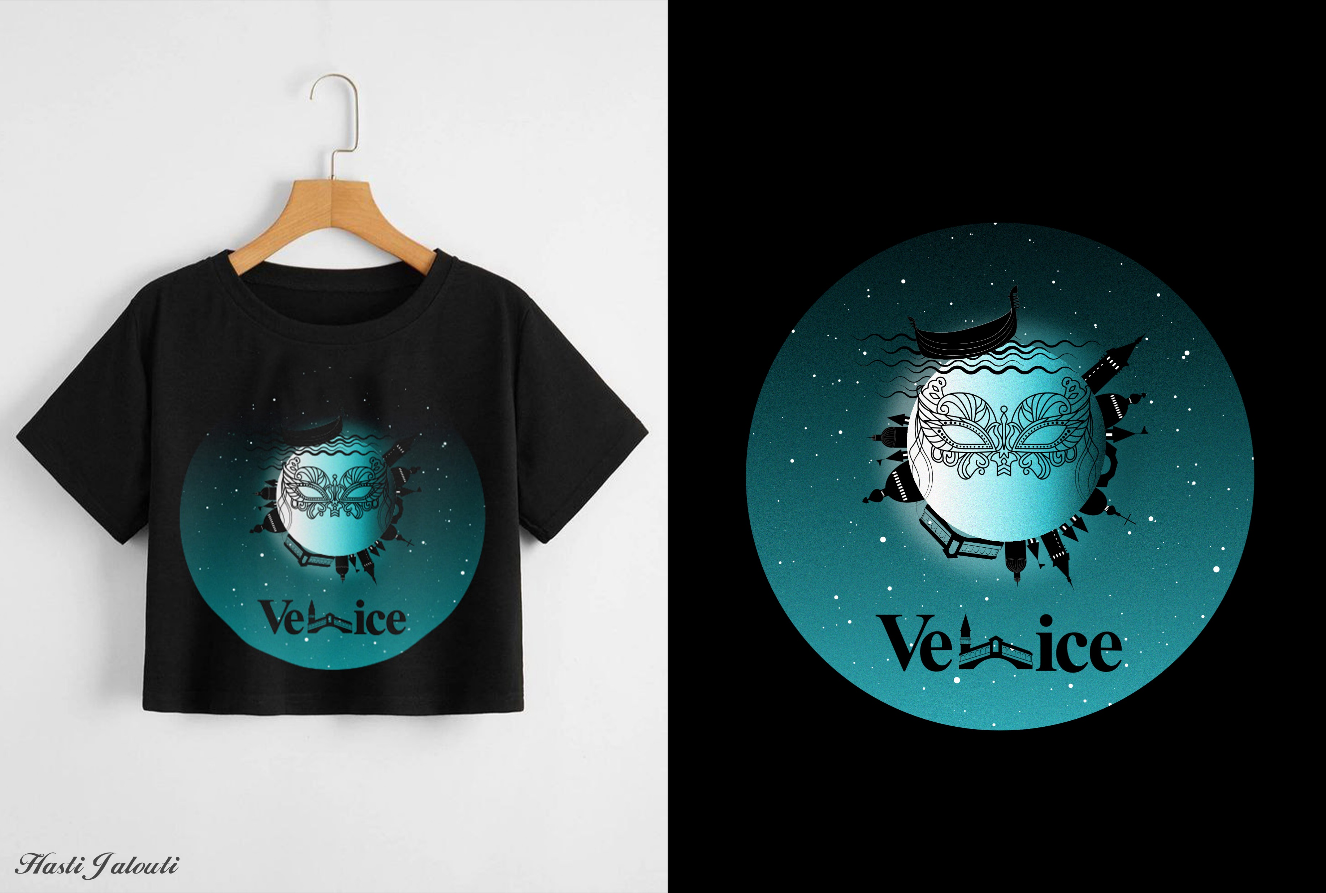
2. Introducing the works
Design No.1600-112 by Ms. Hasti Jalouti, University of Tehran(non-member)
Comment by the chairperson
-Mr. Cho
"The Moon of Venice" is a piece of art that is filled with stars in the night sky of Venice. She decorated the moon at the center by arranging the Gondola and the symbolic buildings in a radial manner so that she can express the surreal atmosphere very well.
It is a masterpiece that expresses the theme well with a strong contrast while minimizing the use of color on black shirts.

Slide 10
2. Introducing the works
Design No.1600-112 by Ms. Hasti Jalouti, University of Tehran(non-member)
Comment by the committee member
-Ms. Eugenia Sainz
The name of this work is “Venice”. The design created by Hasti Jalouti is an excellent Venetian nocturnal that highlights the magical and romantic nature of the city. Venice is depicted as a timeless microcosm supported by the terrestrial sphere in which the typical elements of the Venetian landscape are found: the mask, the gondola, the bell towers, the domes, and the Rialto bridge. The chromatism is very accurate.

